Slide 1
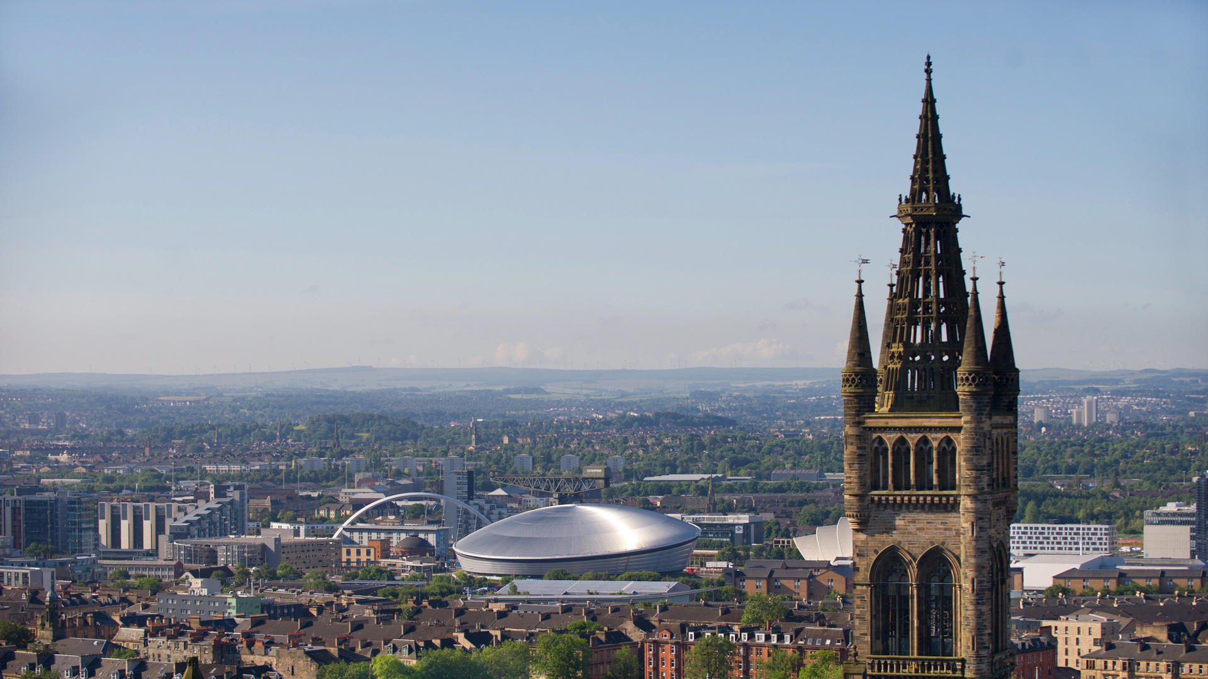

Welcome to the University of Glasgow
Dr Ramona Blanes and Dr Clare McManus
Notes:
Intro slide - If your presentation relates solely to student recruitment, please use this version.

Slide 2
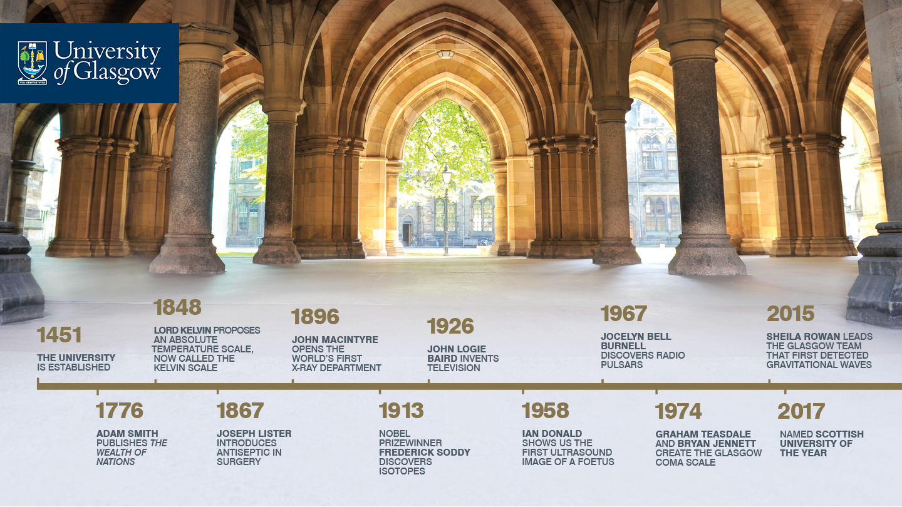

Slide 3
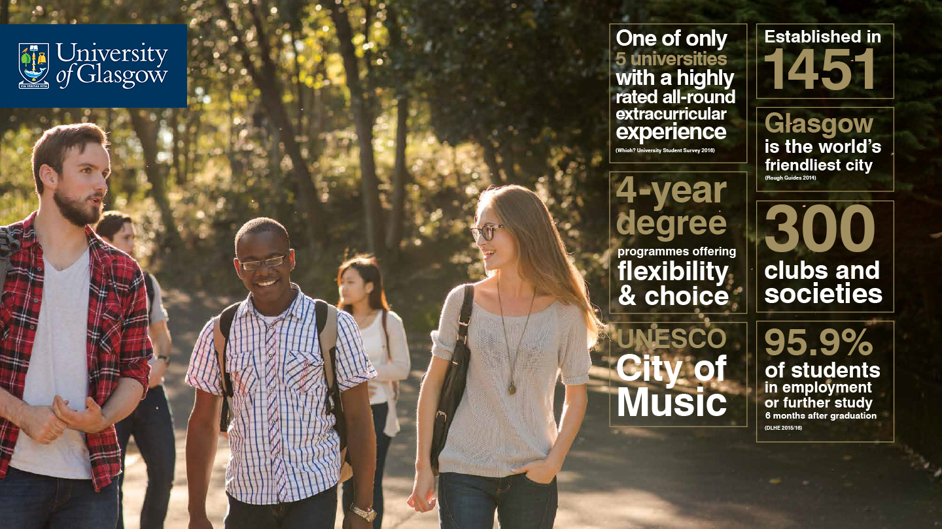

Slide 4
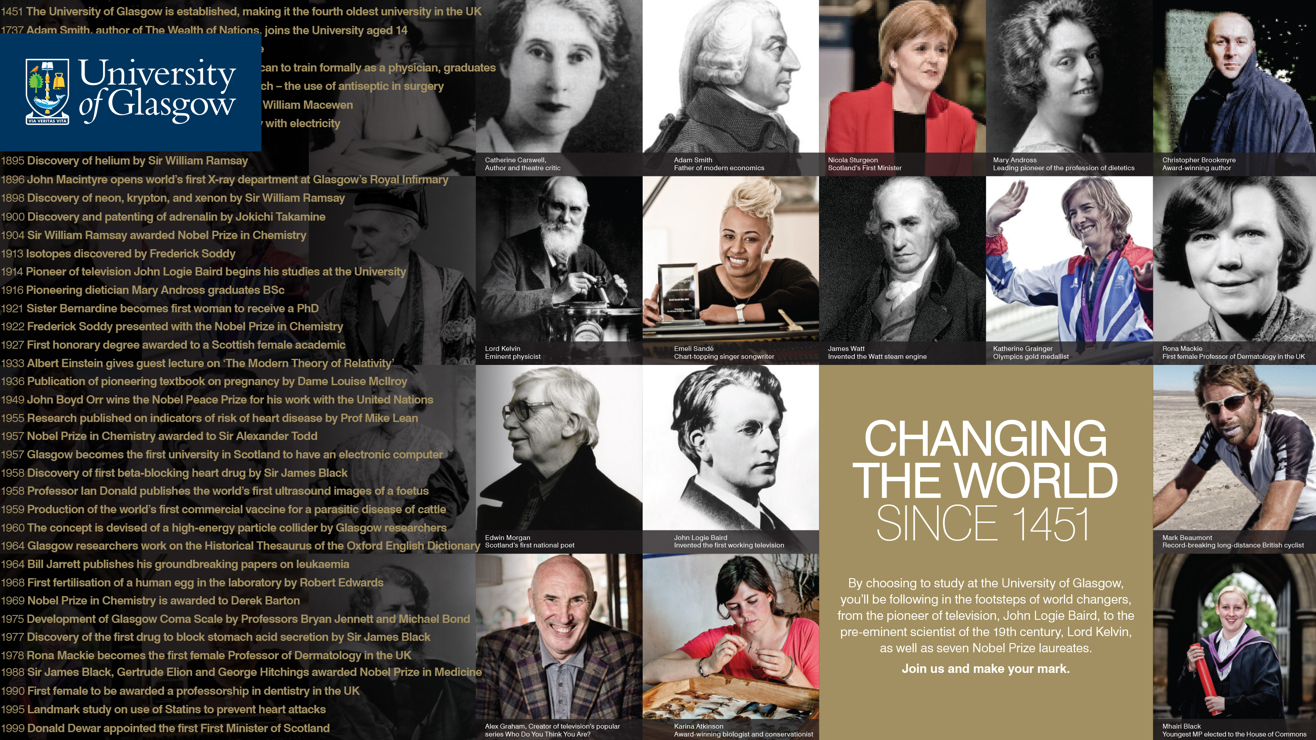
Notes:
Alumni and discoveries have been coming out of Glasgow for over 560 years …
Discoverers / pioneers / developers of economics, steam engine, electricity management, Kelvin scale of temperature, antiseptics, brain tumour removal (1879), helium, neon, krypton and xenon, adrenalin, isotopes, television, beta blockers, ultrasound, concept of a high-energy particle collider, invetro-fertilisation of human eggs, the Glasgow Coma scale, statins, stem cell therapy and more recently gravitational waves and Zika virus … to name but a few!

Slide 5
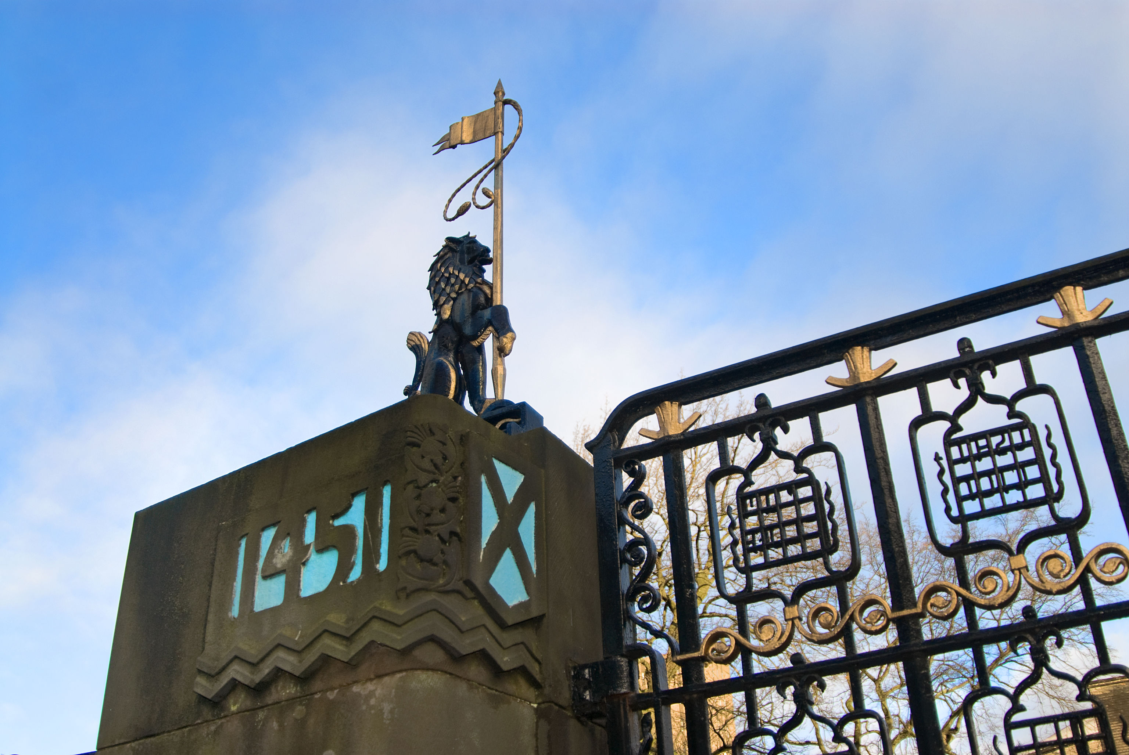
Notable Alumni
Notable Alumni
First Minister for Scotland
Chief Medical Officer for Scotland
Managing Director, Nokia (Australia / New Zealand)
Executive Producer, BBC Wales Commissioning
Trust Board Director, NHS
Writer / Director Partickular Films
In addition Glasgow alumni can be found in the following world leading companies:
Apple, Google, HSBC, JP Morgan, Rolls Royce, Facebook, Oxfam, British Council and L’OReal
Notes:
Notable Alumni
Current senior positions held by alumni:
First Minister of Scotland
Chief Medical Officer for Scotland
Managing Director, Nokia (Australia/New Zealand)
Executive Producer, BBC Wales Commissioning
Writer/Director, Partickular Films
Trust Board Director, NHS
In addition Glasgow alumni can be found in the following world leading companies:
Apple, Google, HSBC, JP Morgan, Rolls Royce, Facebook, Oxfam, British Council and L’OReal

Slide 6

University Rankings
Rankings | Rank
QS World 2018 | 65 5*
THE Global 2018 | 80
UK Russell Group for student satisfaction | Joint 1st
THE Most international universities in the world | 32
Sunday Times/The Times Scottish University of the Year 2018
Winner of the 2013 and 2017 Queen’s Anniversary Prize for Further and Higher Education

Slide 7

Research figures
Active researchers | 2000+
Annual research income | £189.5m
Direct contribution to Scotland’s GDP | 0.5%
Direct contribution to Glasgow’s GDP | 3%+
Research assessed as being world leading or internationally excellent | 80%+
Research power – UK (REF, 2014) | 12th
Top 10 of UK universities of annual research grants and contracts income (HESA)

Slide 8


Research Beacons
Notes:
Characterized by their multidisciplinary approach and engagement with public, private and third sector. Pioneering new treatments for chronic diseases. We support the global cultural and creative economy. Through our Centre for Cultural Policy Research. Answering the world's most complex questions, AI technologies. Improving human and animal health. Global understanding, enabling change. Glasgow is an international centre of excellence in quantum and nanoscience, translating our fundamental understanding of these phenomena into world-changing technologies.

Slide 9

Internationalisation
Founder member of Universitas 21
Strategic University research partners include:
Columbia University, USA
McGill University, Canada
Nankai University, China
Partnerships with 200+ institutions globally
Notes:
Universitas 21 – the world’s leading network of research intensive universities

Slide 10
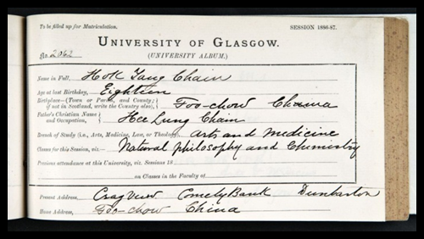
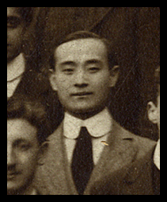
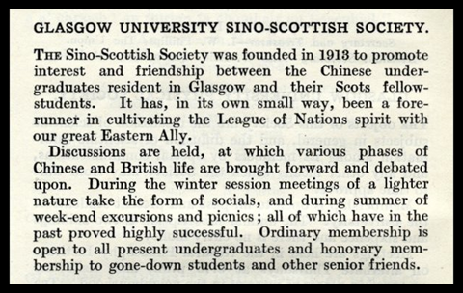
Glasgow’s Chinese Connections
First Chinese student: Hok Tang Chain from Foo-Chow – Natural Philosophy 1886-87
First Chinese graduate: Vivian Ernest Chang from Shanghai – MBChB, 1895
First Chinese PGR graduate: Su Ting - “Studies of the Scottish Shoreline”, 1937
First external examiners: renowned sinologists Professor Herbert Giles and son Lionel Giles of the British Museum
Chinese – Scottish Society established 1913
Currently 2000+ students
YY Liu, Engineering (pic. 1913/14) First president of the Engineering Society
Notes:
YY Liu, Engineering - pictured here in his 1913/14 Engineering class photograph. He was the first President of the Engineering Society

Slide 11
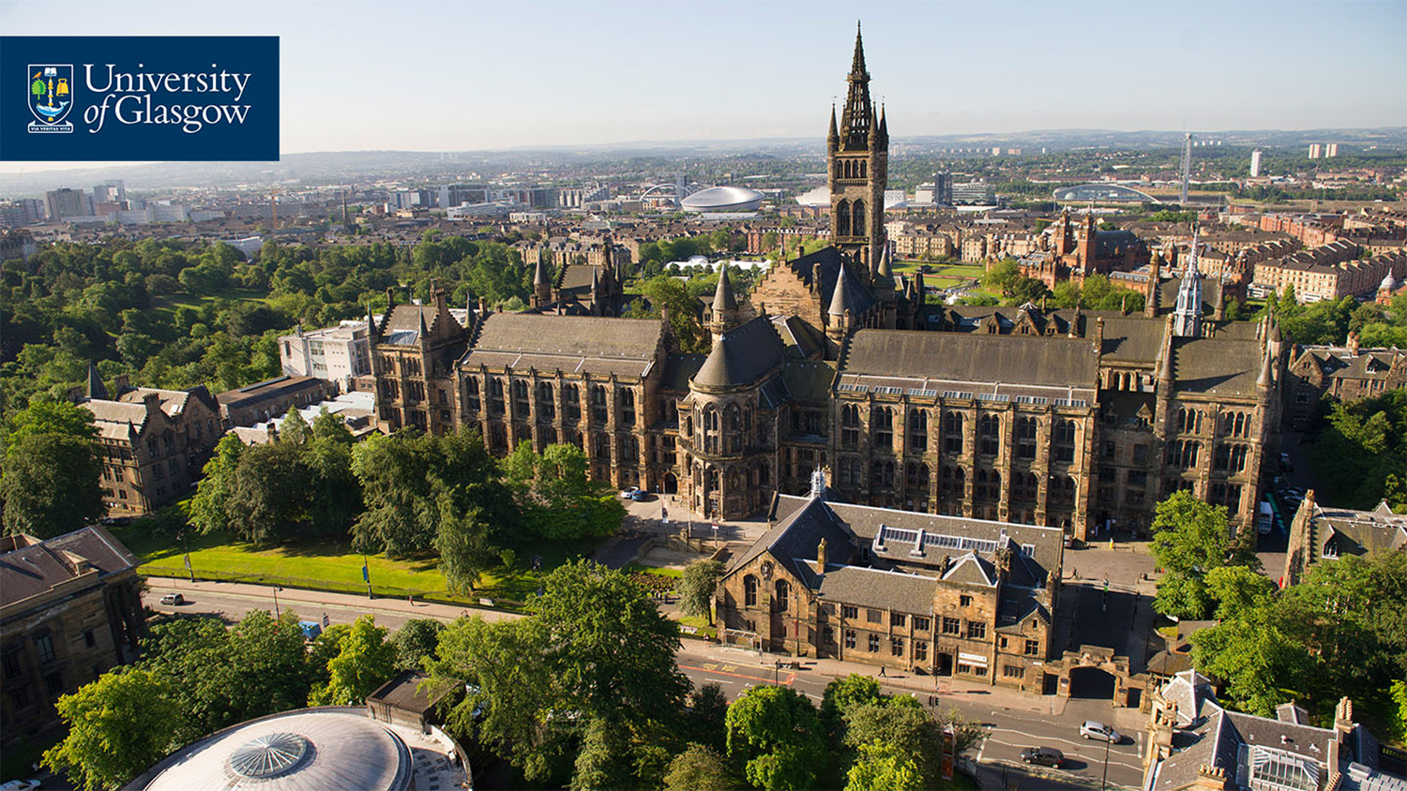
Colleges
The University of Glasgow is comprised of four Colleges:
College of Medical, Veterinary & Life Sciences
College of Science & Engineering
College of Social Sciences
College of Arts

Slide 12
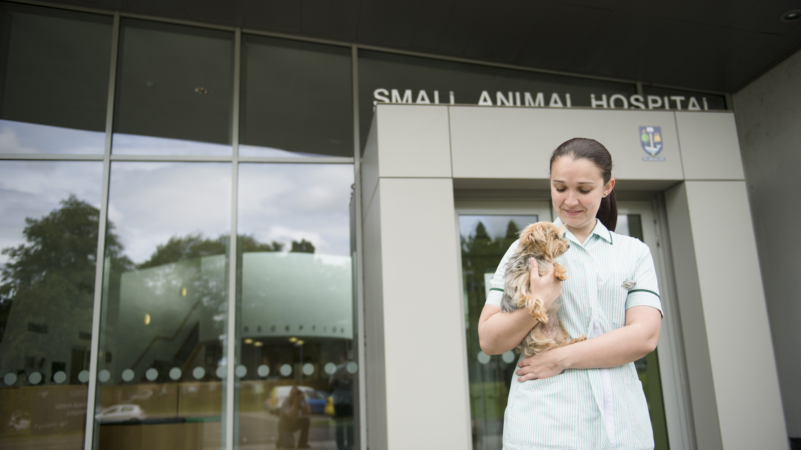
College of MVLS
I
College Facts:
2,000+ staff
6,000+ students from 100+ countries
£80m+ annual research income
Rankings:
3 research submissions in UK Top 10 (REF, 2015)
Medicine, Dentistry, Nursing and Life Sciences are ranked in the top 1 or 2 in the UK in each of their subjects in The Time & Sunday Times Good University Guide 2018

Slide 13
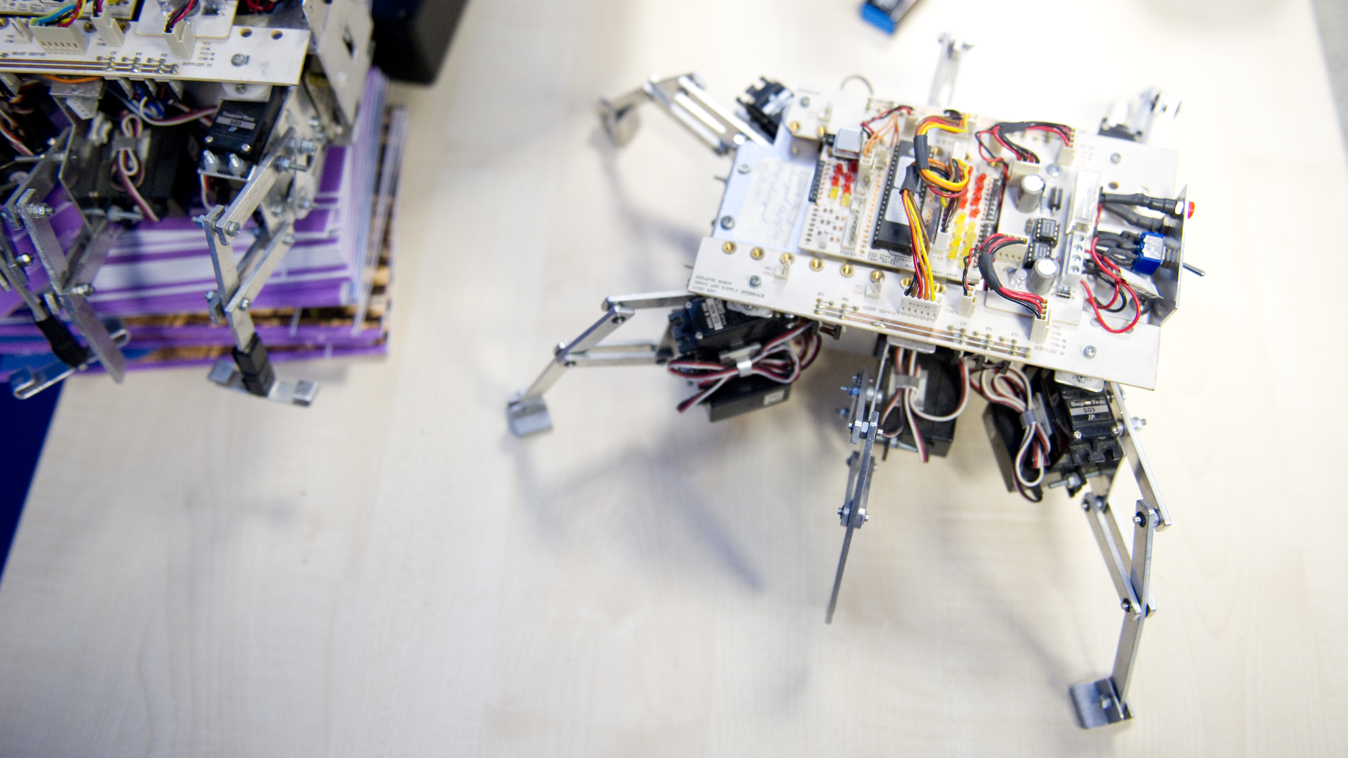
College of Science and Engineering
College facts:
340 academic staff
5219 students based in Glasgow, with 1000 in China and Singapore
525 PGT students (228 international)
645 PGR students (183 international)
£31.9M research income
January intake for some PGT programmes
Notes:
State-of-the-art facilities include:
James Watt Nanofabrication Centre
Electronics Design Centre
Centre for Rehabilitation
Engineering for spinal injuries
Glasgow Molecular Organic
Geochemistry Laboratory
Imaging, Spectroscopy and Analysis Centre
Centre for Cognitive Neuroimaging equipped with state-of-the art brain imaging
Scottish Universities Environmental Research Centre (SUERC)

Slide 14
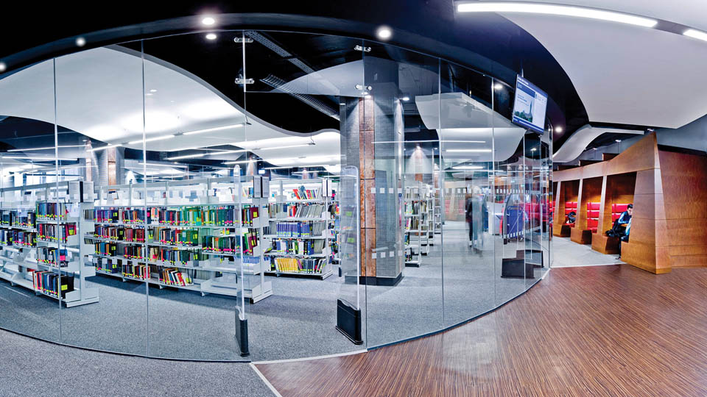
College of Social Sciences
College Facts:
Triple accredited Business School (EQUIS, AACSB & AMBA) – held by <1% of all business schools across the world
Spread across two campuses: Glasgow and Dumfries
Launched Joint Graduate School with Nankai University, China in 2015
Notes:
College Facts:
Tripled accredited Business School (EQUIS, AACSB & AMBS) – held by <1% of all business schools across the world
Spread across two campuses: Glasgow and Dumfries
Launched Joint Graduate School with Nankai University, China in 2015
Rankings - REF 2014 Results:
Architecture, Built Environment & Planning: joint 1st in the UK
Area Studies, Social Policy & Social Work: 1st in Scotland
School of Law: 2nd in Scotland
History: 2nd in Scotland

Slide 15
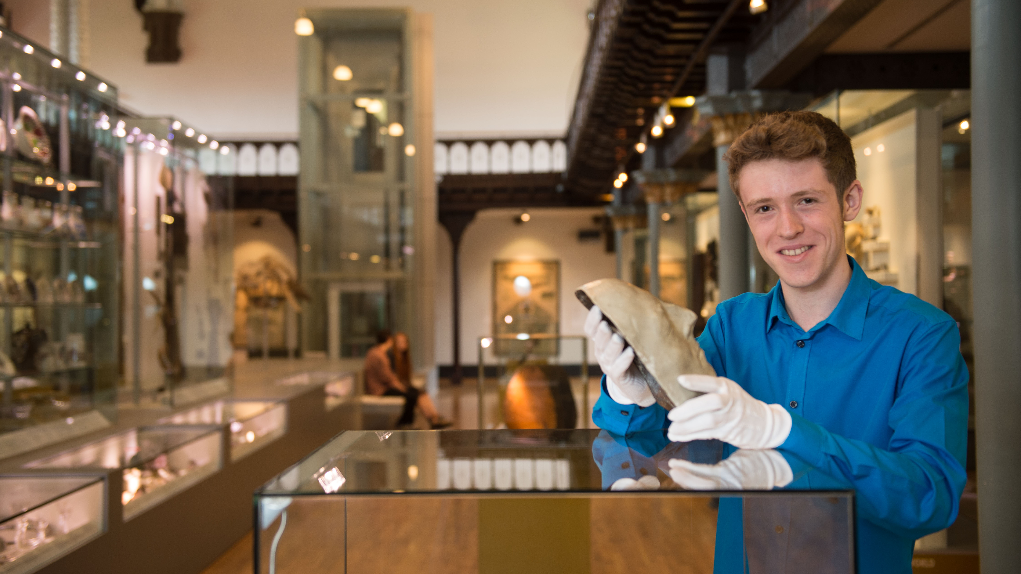
College of Arts
College Facts:
500+ staff / 6000+ Students
Collaborative degrees with GSA and The Royal Conservatoire of Scotland
Rankings:
Ranked 70th for Arts & Humanities in the THE World Rankings (2018)

Slide 16
BSc Single Honours
Undergraduate Degree Path
Year 1 OR FOUNDATION Choose three different subjects according to your interests | MATHEMATICS + PHYSICS + CHEMISTRY LEVEL 1 LEVEL 1 LEVEL 1
Year 2 Continue with two of your first-year subjects | MATHEMATICS + PHYSICS LEVEL 2 LEVEL 2
Years 3 & 4 You’ll study your degree subject exclusively from third year onwards | MATHEMATICS LEVEL 3 & 4
Honours Degree Destination: BSc with Honours in Mathematics

Slide 17
MA Joint Honours
Undergraduate Degree Path
Year 1 OR FOUNDATION Choose three different subjects according to your interests | PHILOSOPHY + HISTORY OF ART + POLITICS LEVEL 1 LEVEL 1 LEVEL 1
Year 2 Continue with two of your first-year subjects & choose another | PHILOSOPHY + HISTORY OF ART + CLASSICS LEVEL 2 LEVEL 2 LEVEL 1
Years 3 & 4 Specialisation in two chosen subjects in the final two years | PHILOSOPHY + HISTORY OF ART LEVEL 3 & 4 LEVEL 3 & 4
Honours Degree Destination: MA with Honours in Philosophy & History of Art

Slide 18
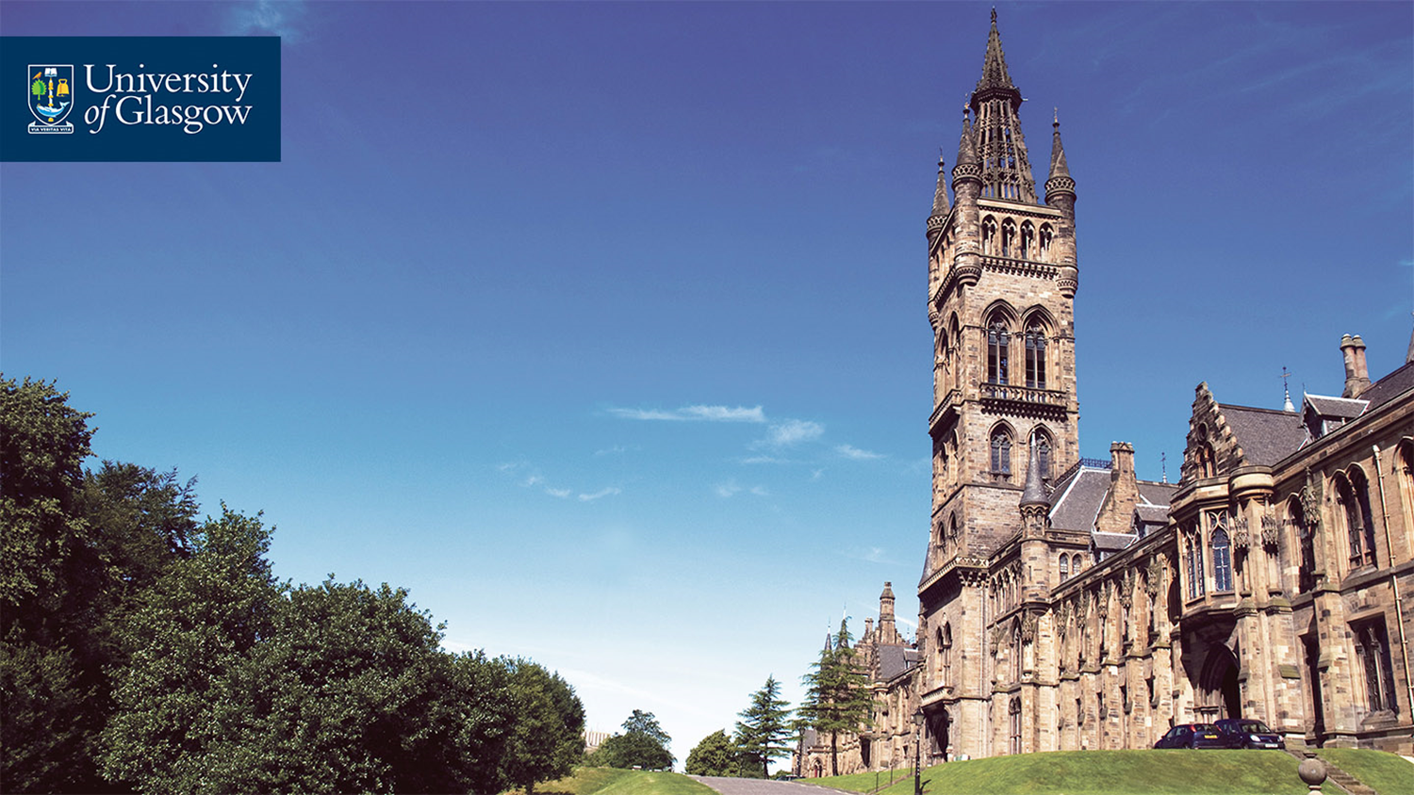
UG Entry Requirements
A-Levels: ABB-AAA
IB: 34-38 points with specific subjects at SL / HL
US: Combination of AP exams, SAT subject tests and SAT/ACT
English Language Requirements:
IGCSE: B or above
IB HL: 5 or above
IELTS: 6.5 (no sub-test less than 6.0)
Notes:
*General requirements – some programmes will have higher entry requirements – You might want to ask Kaplan for the GIC requirements for this?

Slide 19
Postgraduate Taught Degree Path
Duration | Masters: 1 year (full-time study) Diploma: 9 months (full-time study) Certificate: 4-5 months (full-time study)
Degree offered | MSc, MLitt, MRes, PgCert, PgDip
Course assessment | Examination or coursework (or combination of both)
Final assessment | Based on research-based dissertation or project
Overview:
Postgraduate Taught refers to taught degrees with a set amount of contact time with the course providers. This takes the form of seminars, tutorials and lectures.

Slide 20
Postgraduate Research Degree Path
Duration | Doctorate: 3 years (full-time)
Degree offered | PhD
Course assessment | An Annual Progress Report is completed in May of each academic year. A satisfactory progress report is a prerequisite for student registration in the following academic session.
Final assessment | Final assessment involves the submission of a thesis of between 70,000 and 100,000 words
Overview:
A Doctorate may be awarded to a student whose thesis is an original work making a significant contribution to knowledge in, or understanding of, a field of study and normally containing material worthy of publication.

Slide 21
English for Academic Study
Pre-sessional courses in
English offer:
Direct Entry to University
programme for successful
students (no need to take IELTS)
Essential Academic Skills
Flexible Entry Dates to join the
right course for your level
Year-Round Pre-sessional | Pre-sessions Summer A (May)
IELTS 4.5-5.5 overall | IELTS 5.5 in all skills
Pre-sessions Summer B (June) | Pre-sessions Summer C (July/Aug)
IELTS 6.0 overall with no less than 5.5 in any skill | IELTS 6.5 overall with no less than 6.0 in any skill

Slide 22
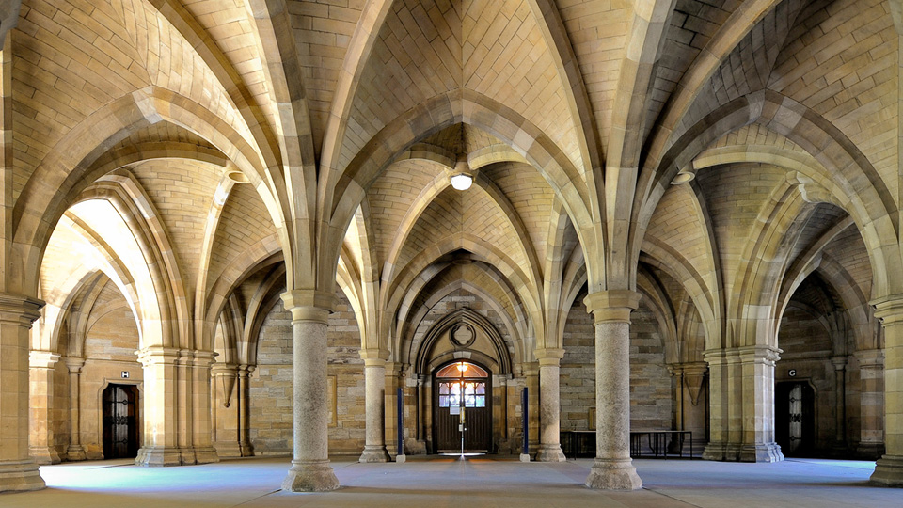
PG Entry Requirements
For PG Taught: Normally a 2.1 or 2.2 Honours degree or equivalent (eg GPA of 3.0 or above) in a relevant subject
For PG Research: First or 2.1 Honours Degree and in some cases a Masters qualification
English Language Requirements:
ibTOEFL: 92 (no sub-test less than 20)
IB HL: 5 or above
IELTS: 6.5 (no sub-test less than 6.0)
Notes:
Update for

Slide 23

Application Requirements
Final or current undergraduate degree transcript (and an official translation)
Degree certificate (and an official translation) if you have already completed your degree
2 references on headed paper
Any additional document specifically listed under 'Entry requirements'
Copy of your passport (photopage) - non-EU applicants only
Notes:
*General requirements – some programmes will have higher entry requirements

Slide 24
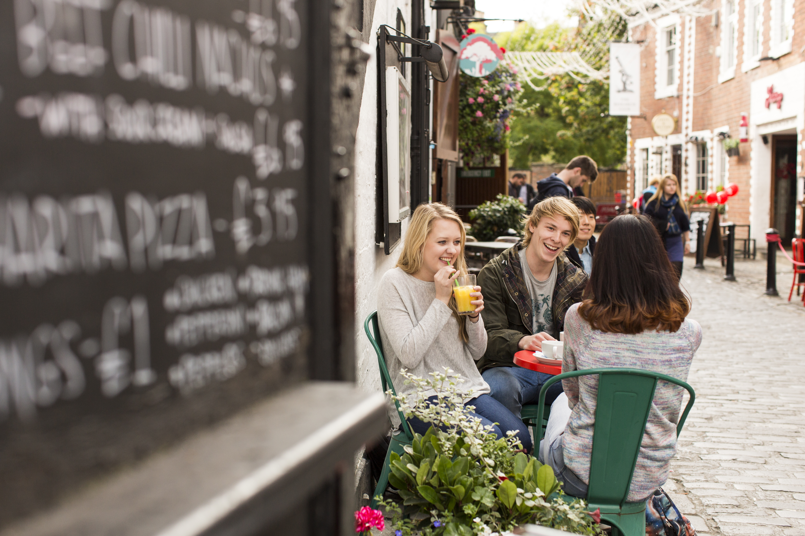
International Tuition Fees
Tuition Fees (per annum) for 2017/18:
Arts & Social Sciences: £16,650
Science & Engineering & non-clinical MVLS: £20,150
Medicine, Veterinary & Life Sciences (clinical): £34,850
This is only a guide and variations do occur
Notes:
You might want to change the currency?

Slide 25
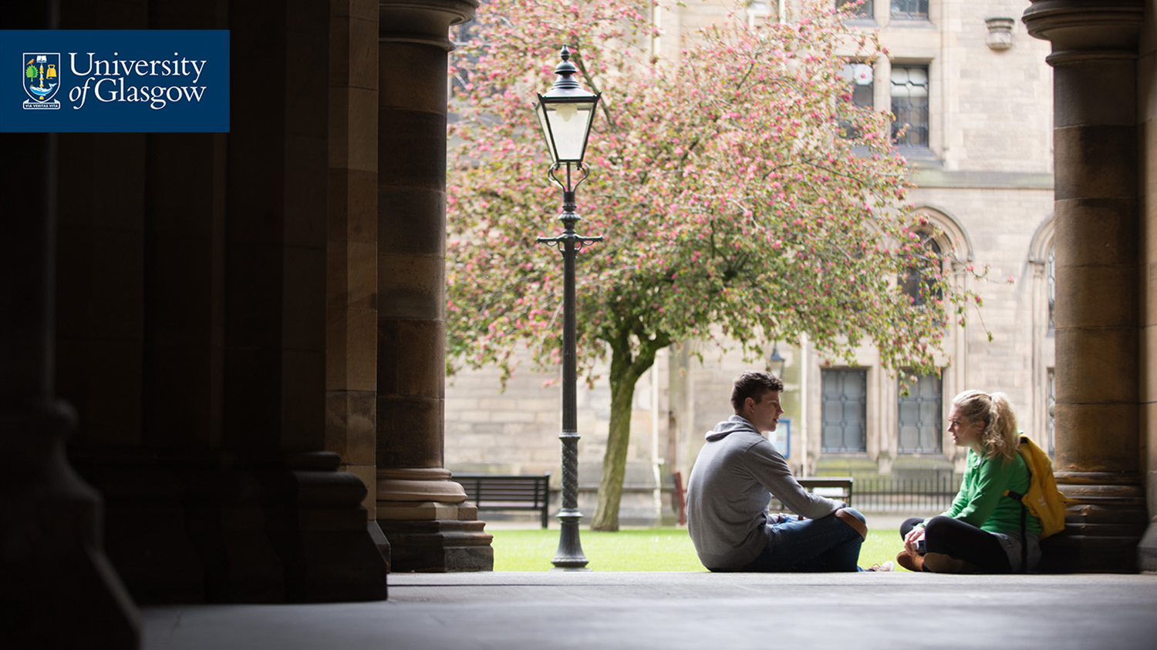
Expenses
Living expenses per month (approx):
Accommodation: £470
Food: £180
Clothes: £70
Travel: £40
Miscellaneous: £30
Phone/internet: £40
Entertainment: £120
Monthly Total: £950
Notes:
Annual Total: £11,400

Slide 26
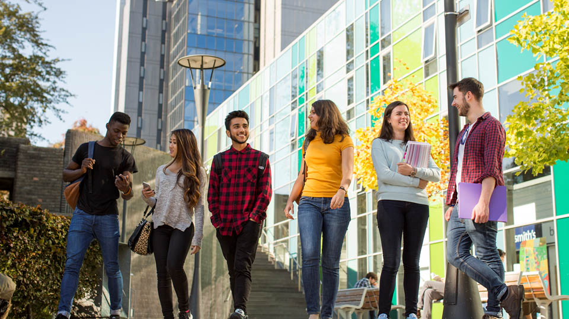
Student Life
Two student unions: Glasgow University Union and Queen Margaret Union
250+ clubs and societies
Glasgow’s own student newspaper and radio station
Student Representative Council
Notes:
Two student unions:
Award-winning Glasgow University Union has 5 social areas, libraries & is home to the most successful debating institution in the world.
Queen Margaret Union is 125 years old & hosts gigs, open mic & club nights. 3 time winner of the Student Union of the Year award
Clubs & Societies:
250+ clubs and societies including the Cheese society and Cut! Filmaking
Glasgow’s own student newspaper and radio station
Student Representative Council:
The SRC voice your opinions – it’s run by students for students

Slide 27

Student Life
Academic Advisor
Ask a Student
Barclay Medical Centre
Careers Service
Chaplaincy for all faiths
Disability Service
International Student Support
IT Helpdesk
Language Centre
Nursery
Student Counselling & Psychological Services
Student Representative Council
Student Service Enquiry Team

Slide 28
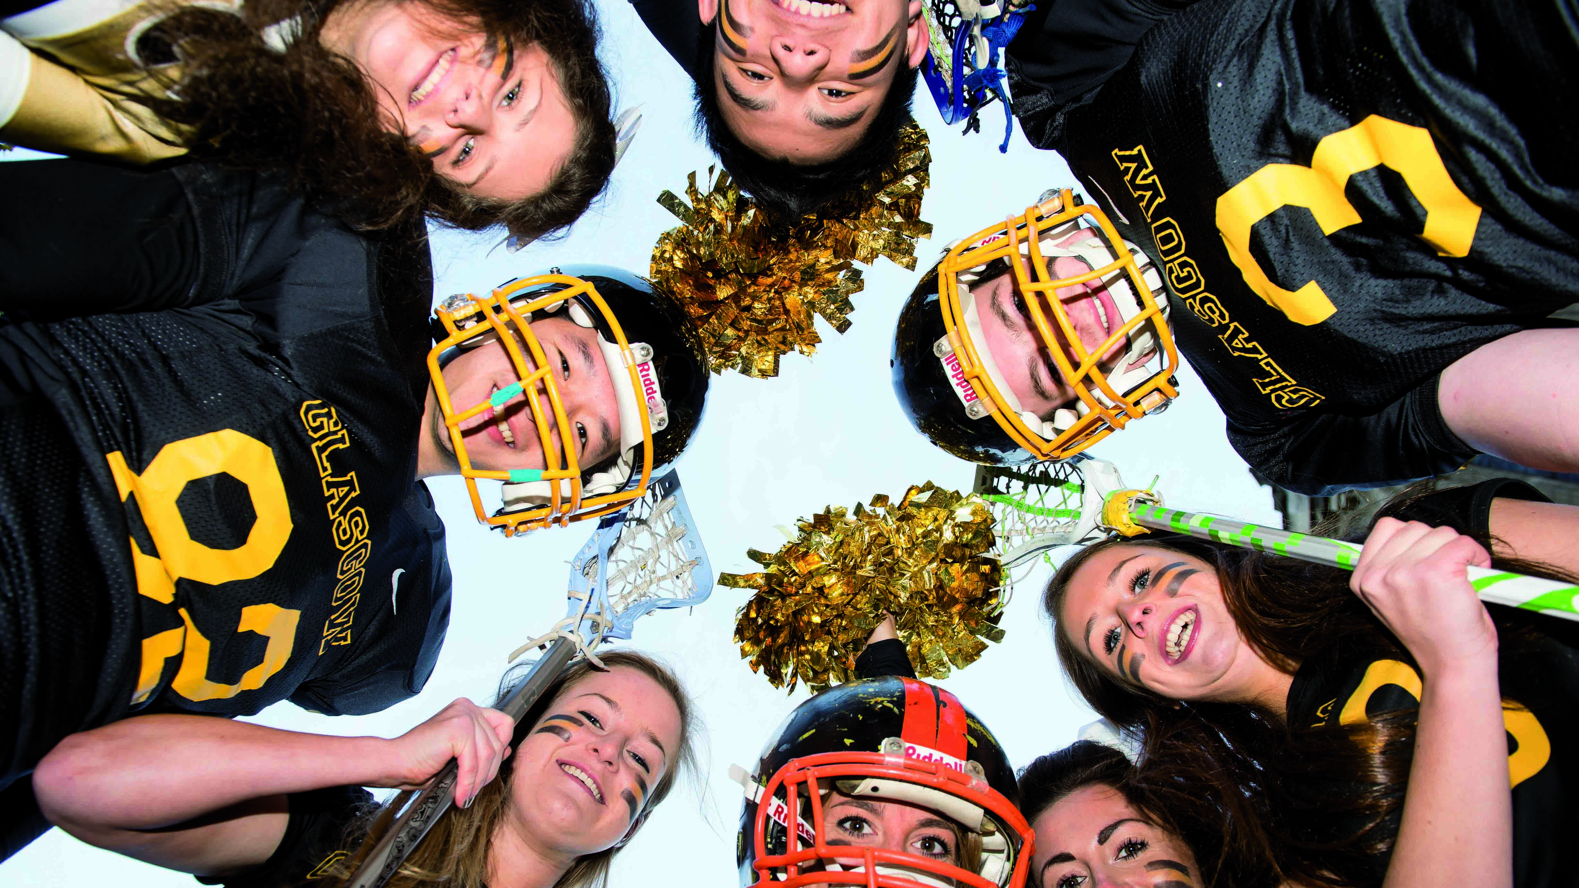
Student Life: Sport
New £10m+ extension to sporting facilities
15,000 members & 49 different sports clubs
2 purpose-built facilities open 7 days a week
6-lane 25 metre heated pool; sauna & steam room; fitness suite; squash courts; six grass & 2 all-weather pitches; cricket oval & tennis courts
Cross-country, mountain climbing, cycling, surfing, snowboarding & more!
Notes:
Opened end of 2015

Slide 29

International Student Support
International Orientation Programme provides information on:
Working in the UK
Finance
General welfare
Health
Immigration
Opportunities to socialise and visit the local area
Glasgow International Airport pickup available in September

Slide 30

Accommodation
Guaranteed accommodation (application deadline end of August)
6 undergraduate student residences and
6 postgraduate student residences
Walking distance to main campus
Wifi included
Notes:
Benefits include:
Trained pastoral staff living on-site
Group insurance cover for your belongings
Sport and recreation facilities membership – reduced fee
On-site coin-operated laundries

Slide 31
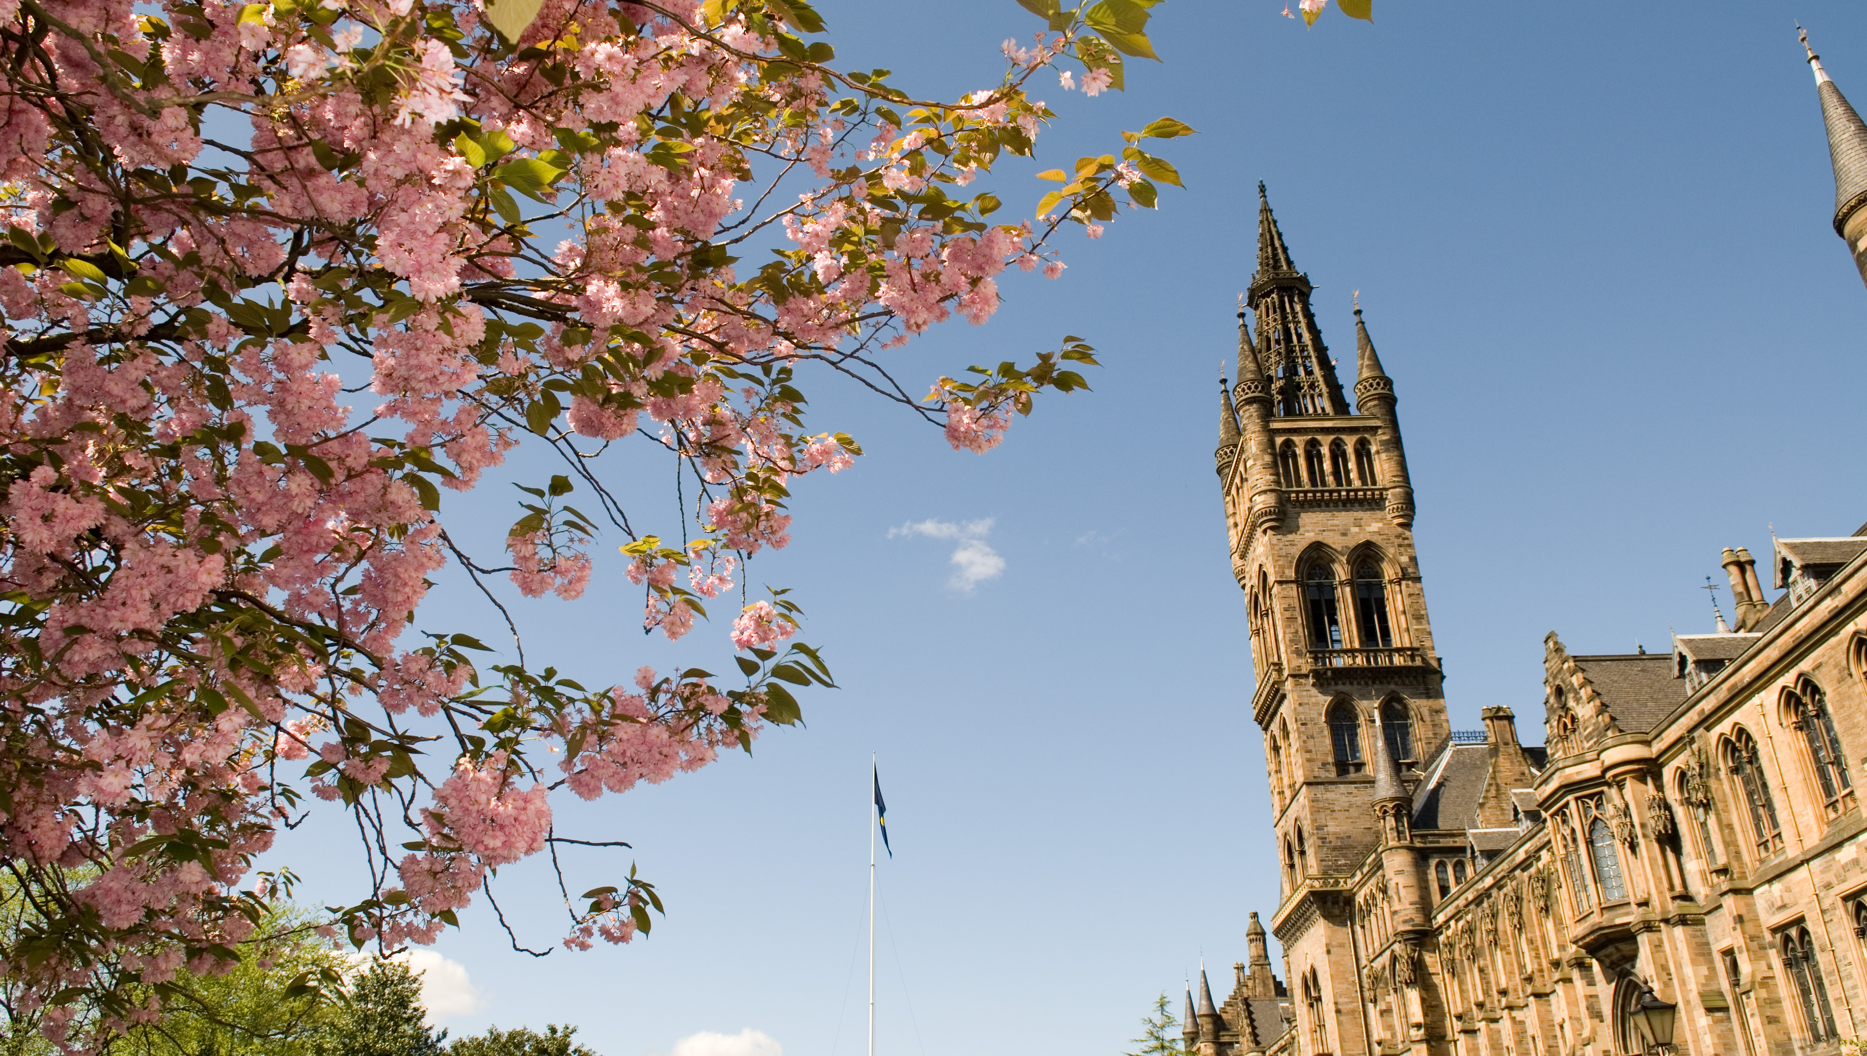
Campus Development
Western Infirmary Expansion:
14 acre Western Infirmary site
£1bn development plan
New buildings and improve historic buildings
New learning and teaching hub
Investing in infrastructure
Further Developments:
Kelvin Hall – first phase opened September 2016
The Queen Elizabeth University Hospital
Research and Innovation Hub
Notes:
£10m+ extension to sporting facilities opened late 2015
Comment: Investing more in infrastructure than was spent in the 2014 Commonwealth Games

Slide 32
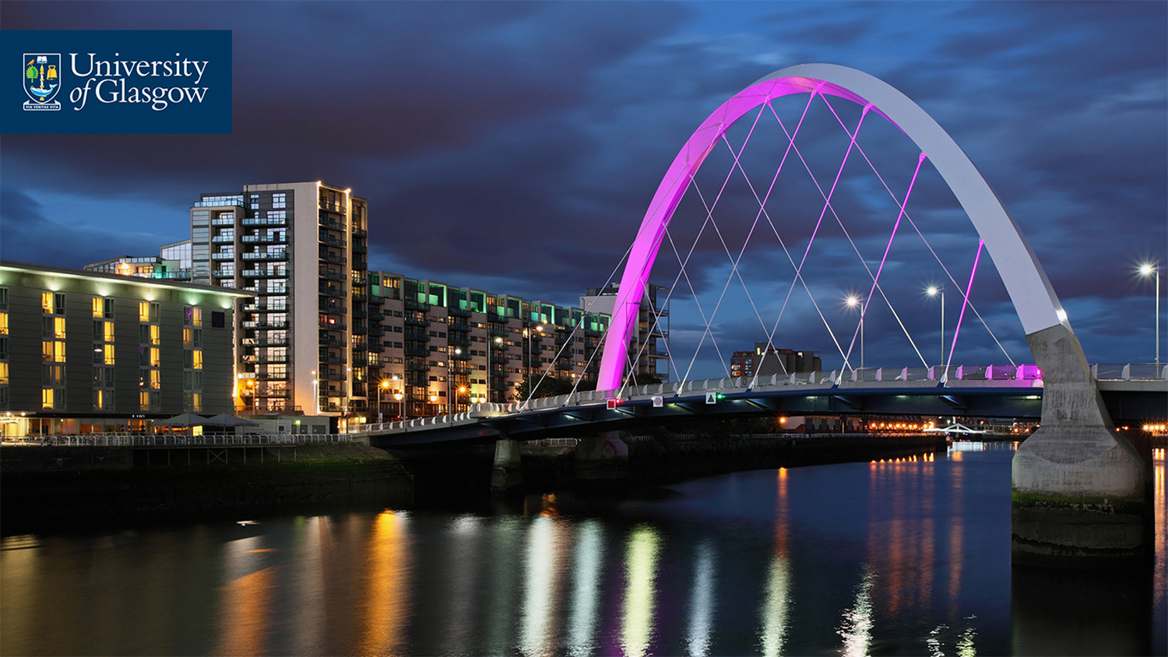
Glasgow
‘Best of the World’ list by National Geographic, 2015-16
People:
Glasgow was recently named the world’s friendliest city (Rough Guides 2016). People make Glasgow!
Shopping:
Voted the top place to shop in the UK outside of London with its famous ‘style mile’
Parks:
90+ parks and public gardens resulting in our name ‘dear green place’
Notes:
Glasgow is the largest city in Scotland and is home to many institutions including the Scottish Ballet, Scottish Opera, Scottish Theatre, the BBC and STV headquarters

Slide 33
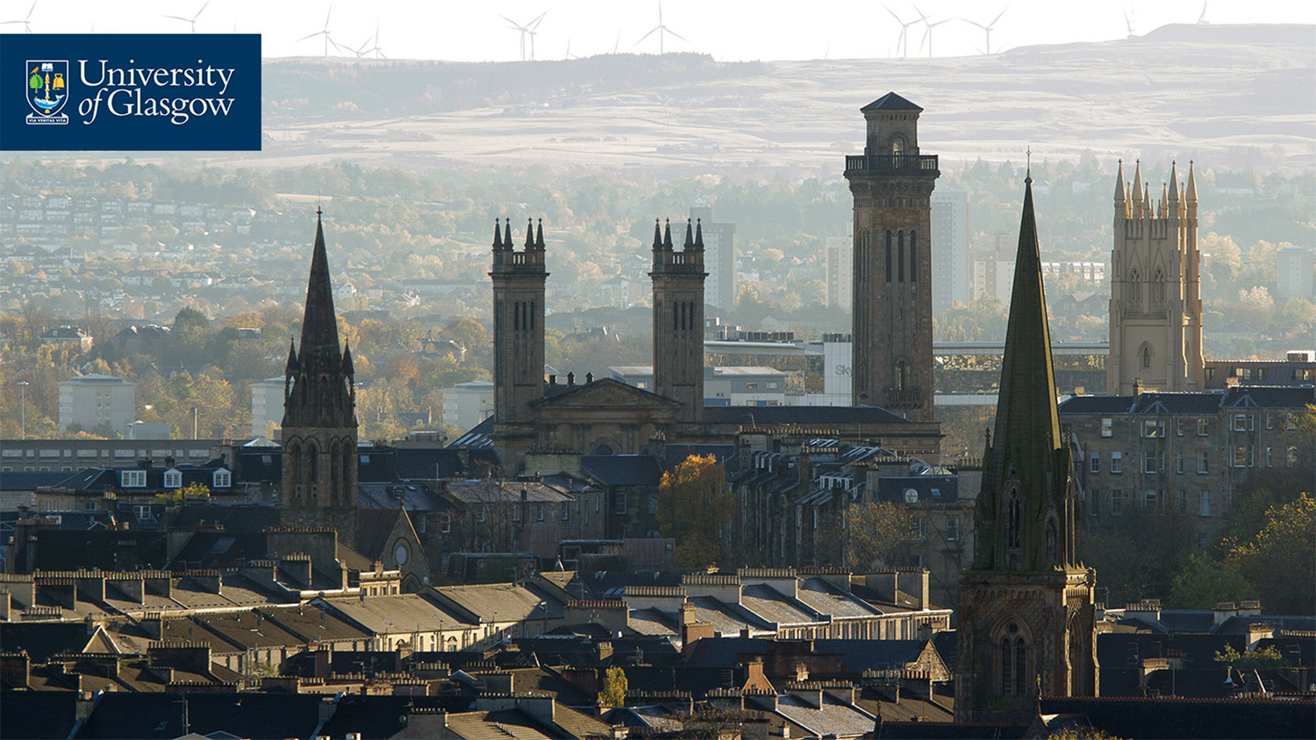
Glasgow
Music:
UK’s first UNESCO City of Music, host to 130+ music events every week
Venues:
SSE Hydro to the legendary King Tut’s and Barrowlands
Culture:
20+ museums & art galleries (many with free entry)
Nightlife:
700+ bars, pubs & nightclubs and 7 cinemas (including the tallest in the world!)
Notes:
Venues:
SSE Hydro - 12,000 capacity SSE Hydro
Culture:
20+ museums & art galleries (many with free entry)
Nightlife:
Glasgow’s nightlife is unrivalled
Cinema is tallest in the world

Slide 34
West End
Ashton Lane:
Charming cobbled lane full of character with an array of restaurants, cafes and bars
Entertainment:
Grosvenor Cinema & Oran Mor
The Kelvingrove Art Gallery and Museum:
One of the most visited museums in the UK outside of London
Kelvingrove Park & The Botanic Gardens
Notes:
The University is nestled within Glasgow’s West End packed full of cafes, bars, vintage boutiques and cultural attractions
Oran Mor:
A converted church where you can settle down to enjoy lunchtime theatre known as A Play, a Pie and a Pint!
Grosvenor Cinema – boutique cinema on Ashton Lane with comfy seats and wine service

Slide 35
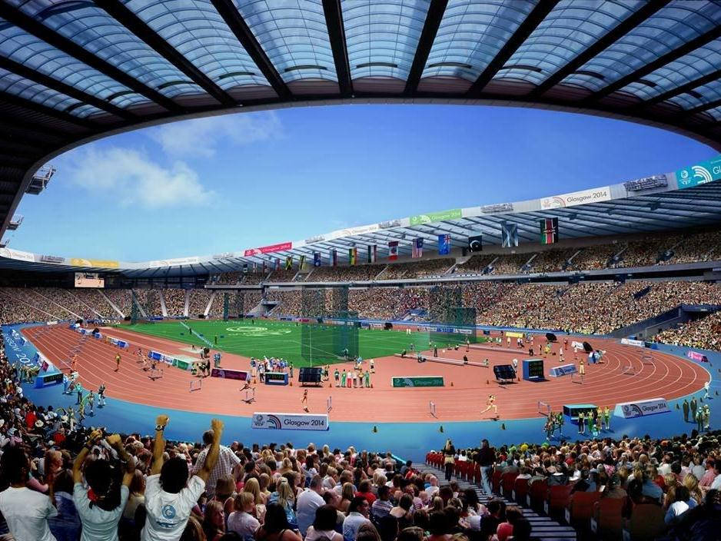
Glasgow Sport
Host city of 2014 Commonwealth Games
Facilities include Chris Hoy Velodrome, Hampden Park and an indoor snow slope to name a few
Glasgow will host the 2018 European Championships and is one of 13 host cities for UEFA Euro 2020

Slide 36
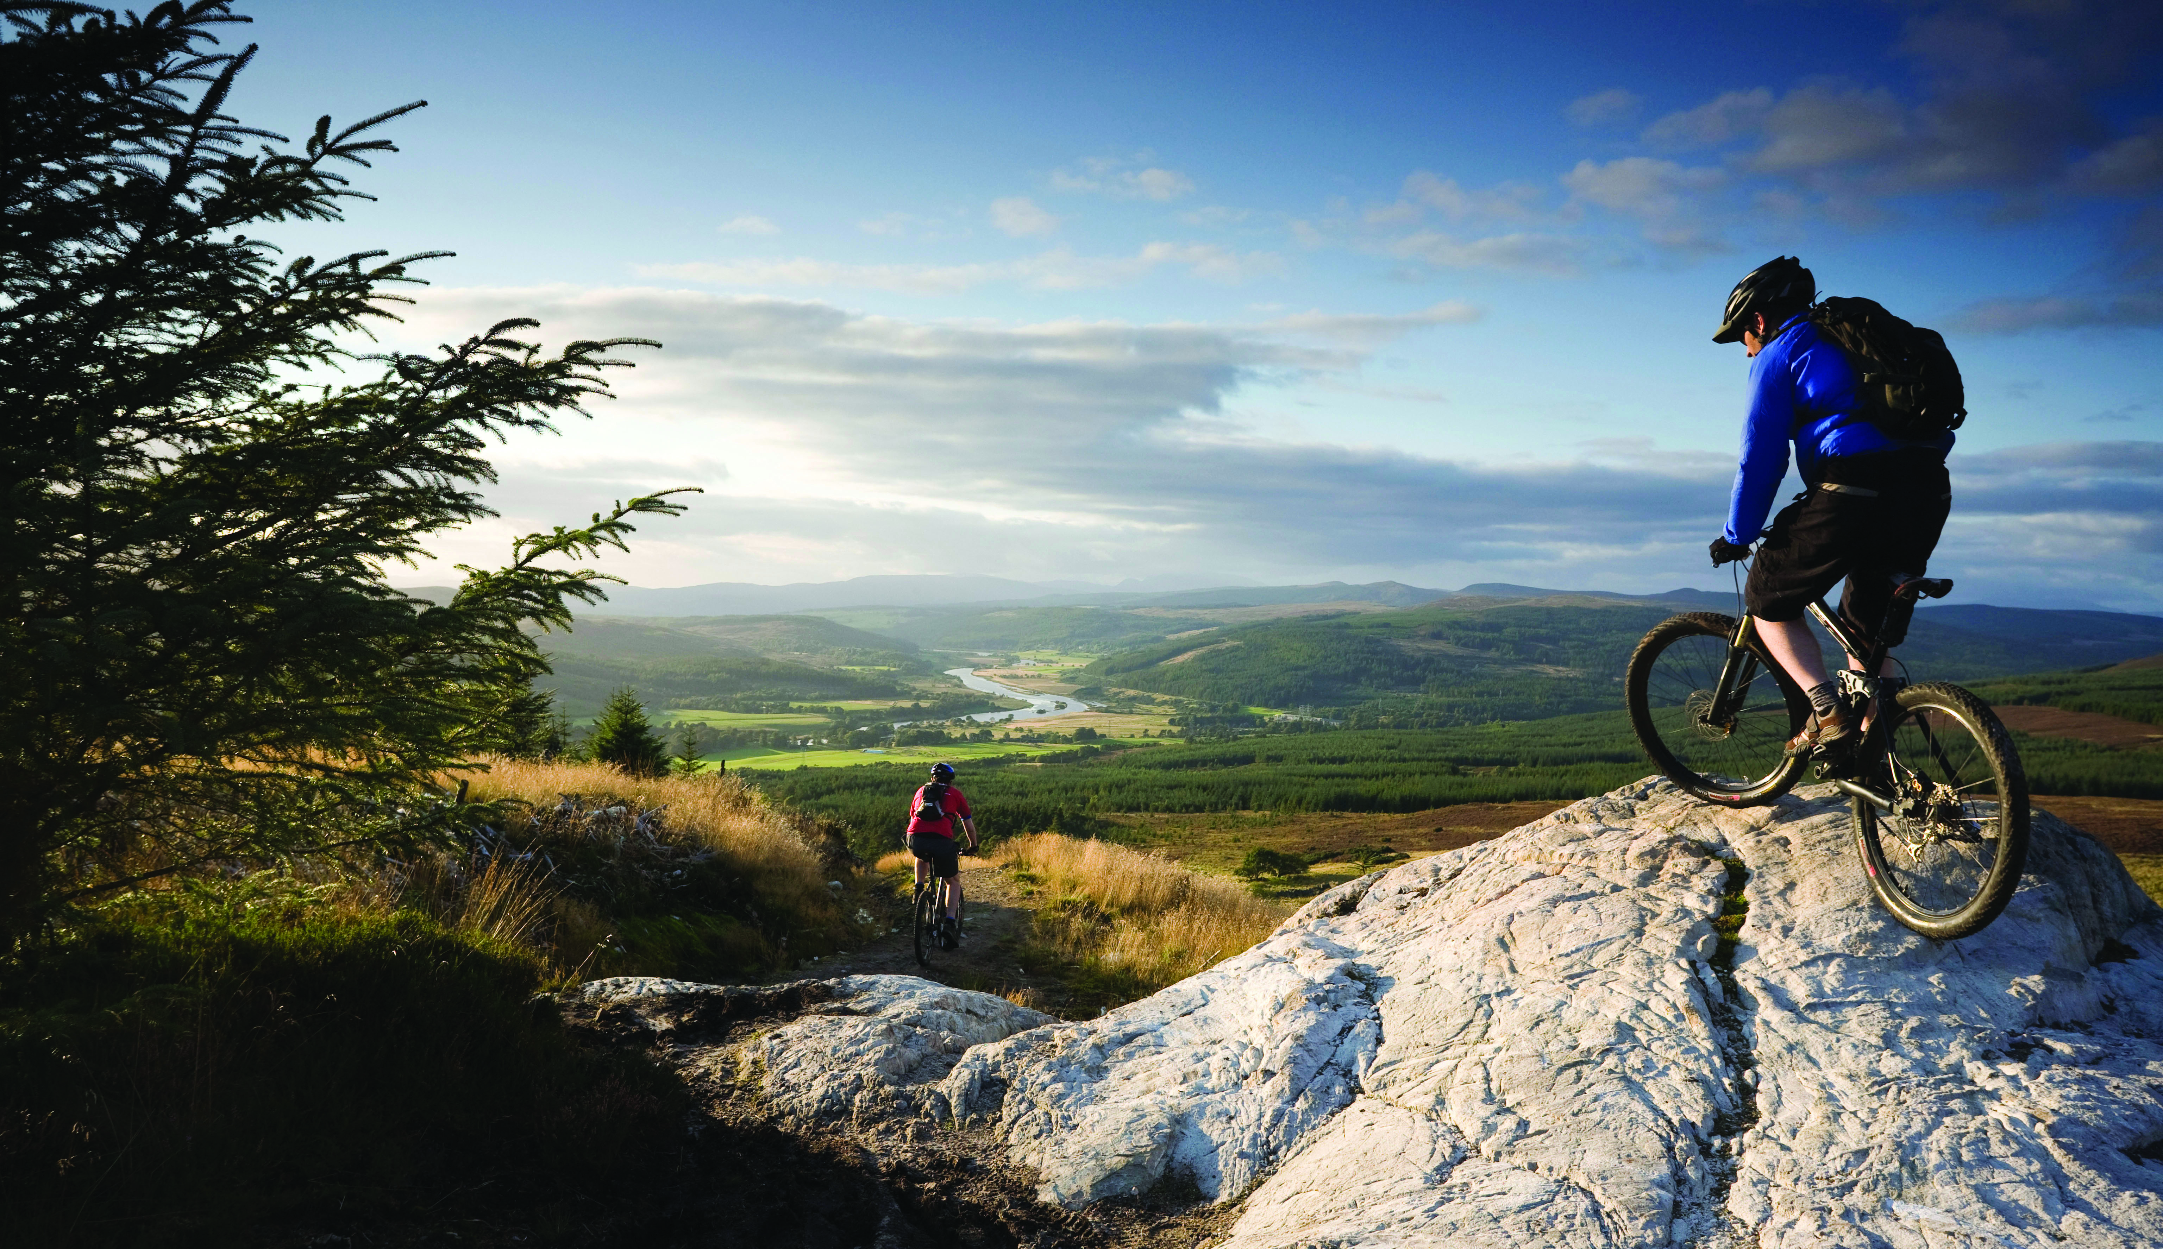
Scotland
Loch Lomond:
Scotland’s first national park and the largest loch in the UK
Outdoor Activities:
Hill climbs, mountain adventures, skiing and snowboarding
Culture & Architecture:
Thriving arts, proud culture scene, spectacular architecture
Parks & Gardens:
Stunning parks, botanic gardens, woodland, countryside and castle grounds
Notes:
From adventure sports to some of the world’s best loved cultural festivals, there’s so much to discover in Scotland
Loch Lomond: 40 minutes away
Outdoor Activities: within 3 hours

Slide 37
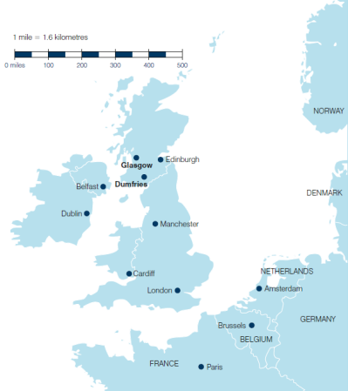
By Air
There are three international airports in Scotland with one in Glasgow:
Glasgow to | Journey time
London | 1 hour 10 mins
Amsterdam | 1 hour 40 mins
New York | 7 hours
Dubai | 7 hours 15 mins
By Train
Two train stations in the city centre link to all major stations in the UK:
Glasgow to | Journey time
Edinburgh | 50 mins
Newcastle | 2 hours 30 mins
London | 4 hours 30 mins
Cardiff | 7 hours

Slide 38
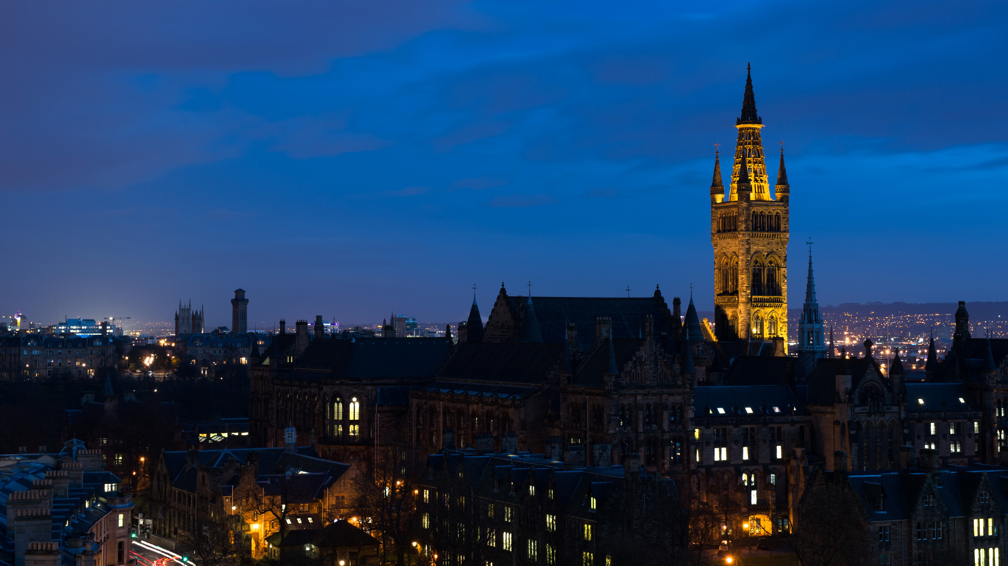








Any Questions?
Ramona.Blanes@glasgow.ac.uk
Clare.McManus@glasgow.ac.uk
/glasgowuniversity
@UofGlasgow
@UofGlasgow
UofGlasgow
Search: University of Glasgow

